Slide 1
Underwater Hyperspectral Images
Martin Kvisvik Larsen

Slide 2
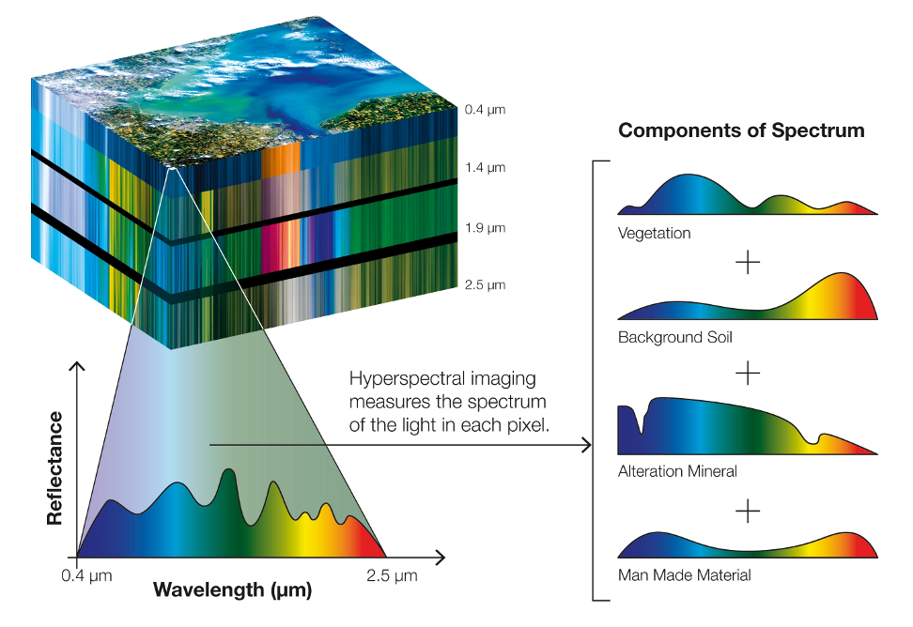
What is hyperspectral imaging?
Hundreds or thousands of light bands
Remote sensing
Hypercube

Slide 3
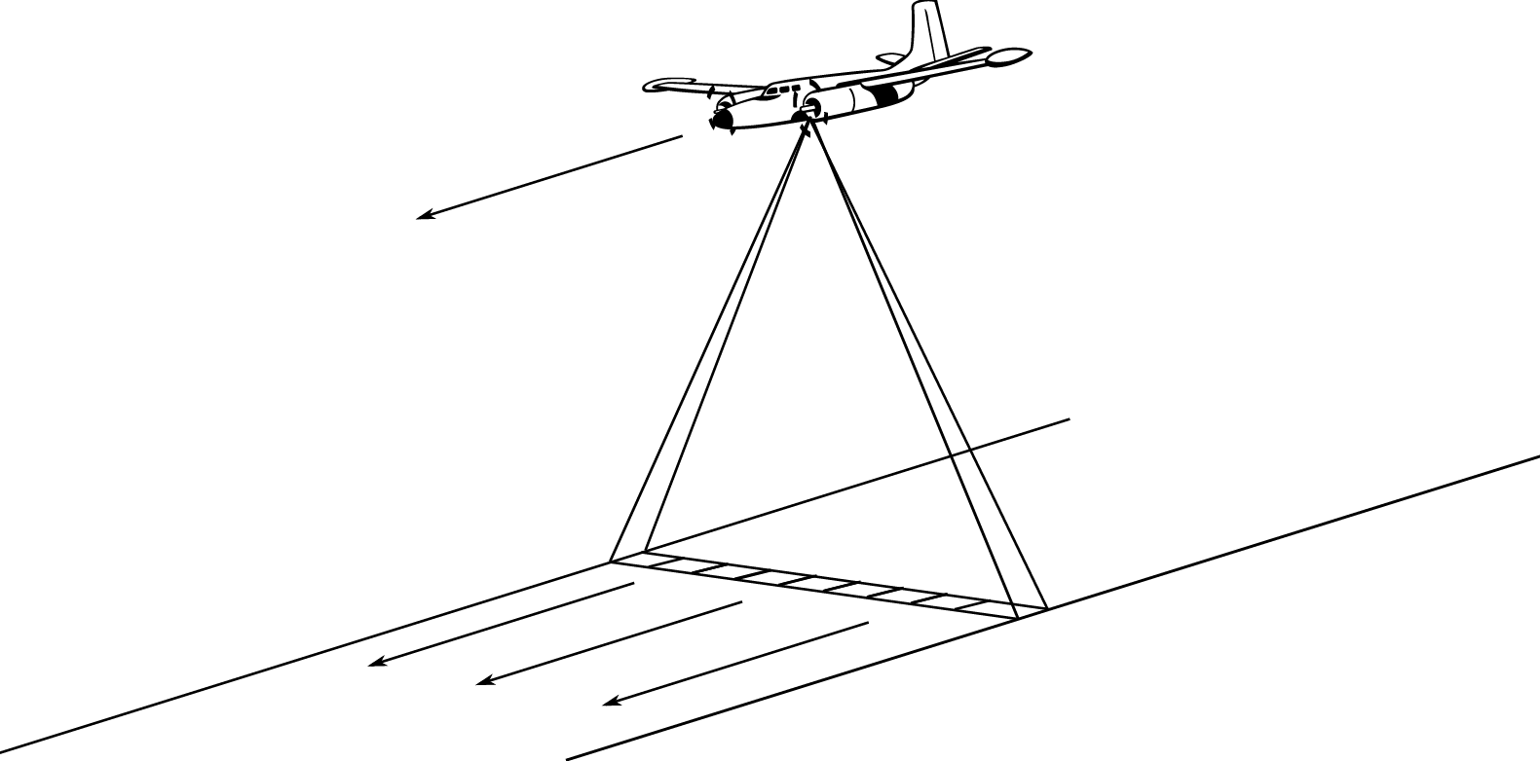
The pushbroom approach
1D scan line
Mosaicking of scan lines
Requires navigation data!

Slide 4
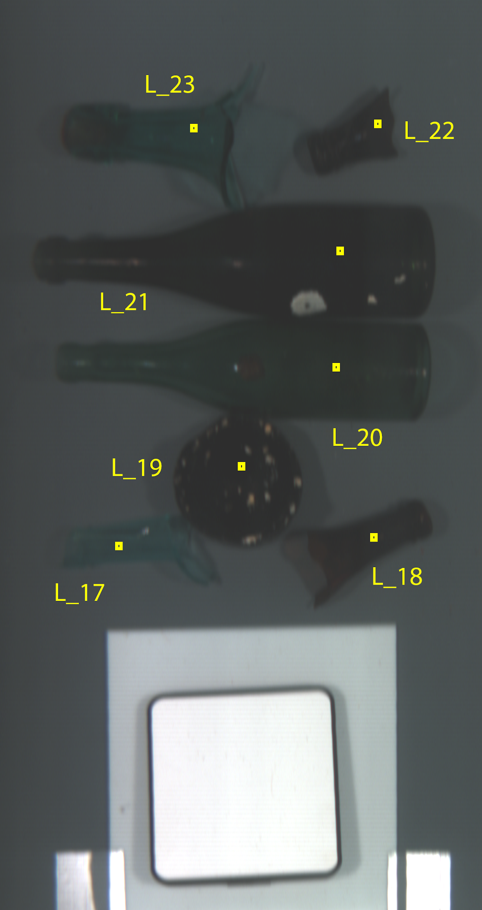
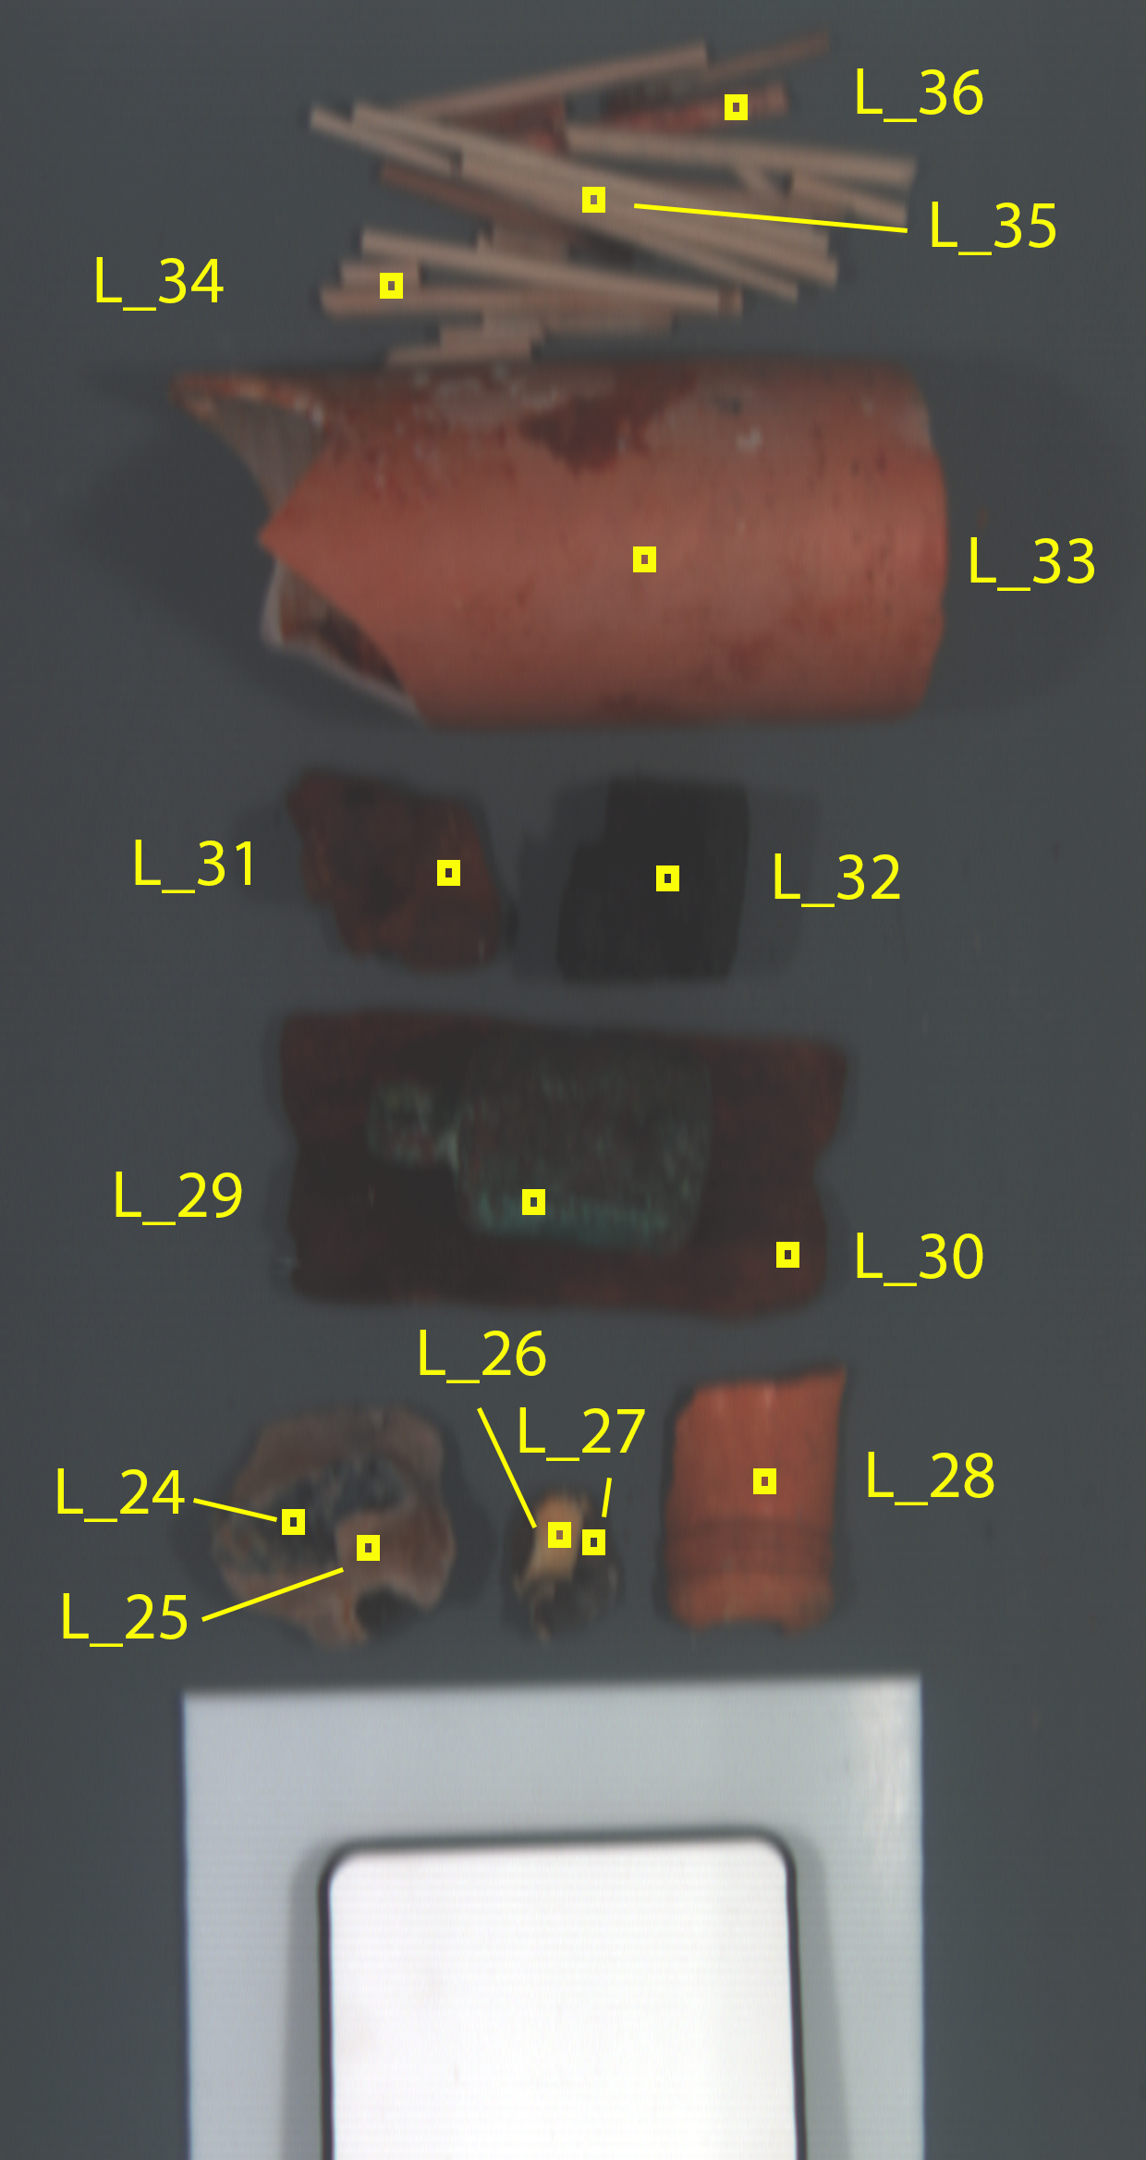
My data: Hyperspectral scan lines
Shipwreck close to Svalbard
Marine artifact references
UHI mounted on ROV
221 million data points!
Number of bands | - | 450
Spectral range | nm | Unknown
Spatial resolution | - | 960
Frequency | Hz | 24
Number of scan lines | - | 511
Time series duration | s | 22

Slide 5
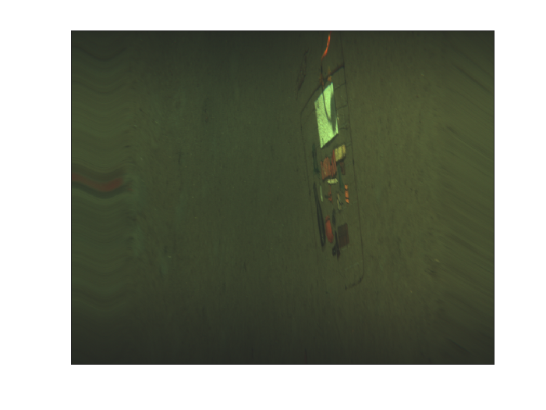

Slide 6
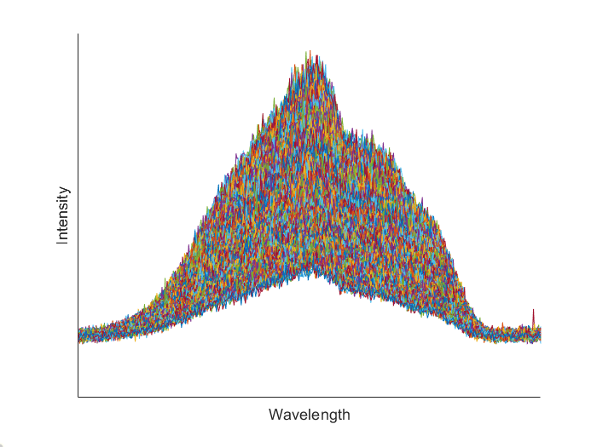
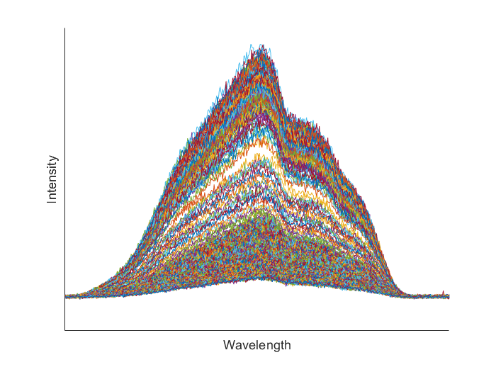
My data: Hyperspectral scan lines

Slide 7
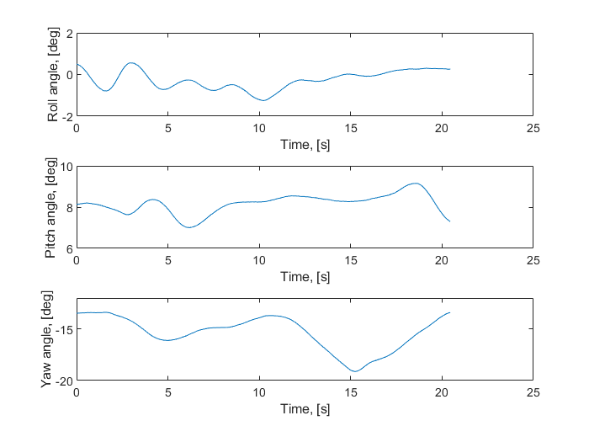
My data: IMU navigation data
Time series
Accelerations
Angles
Turn rates
Temperature
Magnetic field

Slide 8
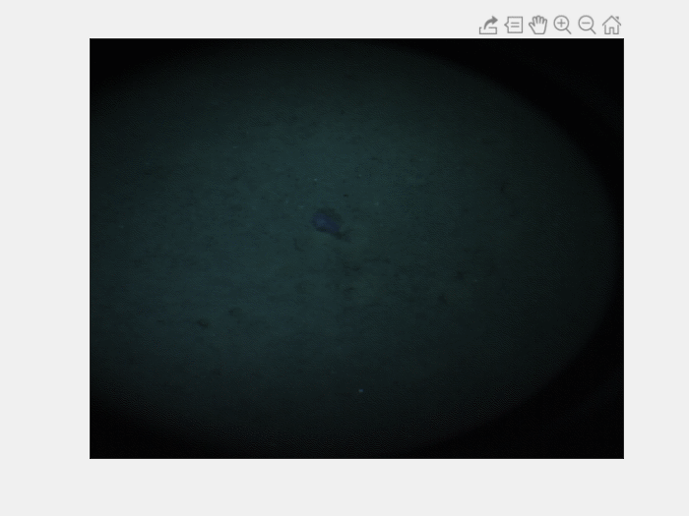
My data: RGB images
Monocular RGB camera
Width | - | 486
Height | - | 648
Frequency | Hz | 2.5
Number of images | - | 51
Time series duration | s | 20

